Slide 1
Mini-workshop on Instrumentation for the
In Situ Exploration of Europa and Ocean Worlds
Europa Lander Pre-Project Science and Engineering teams June 26, 2019
1/3/2019
Pre-Decisional Information - For Planning and Discussion Purposes Only
1

Slide 2
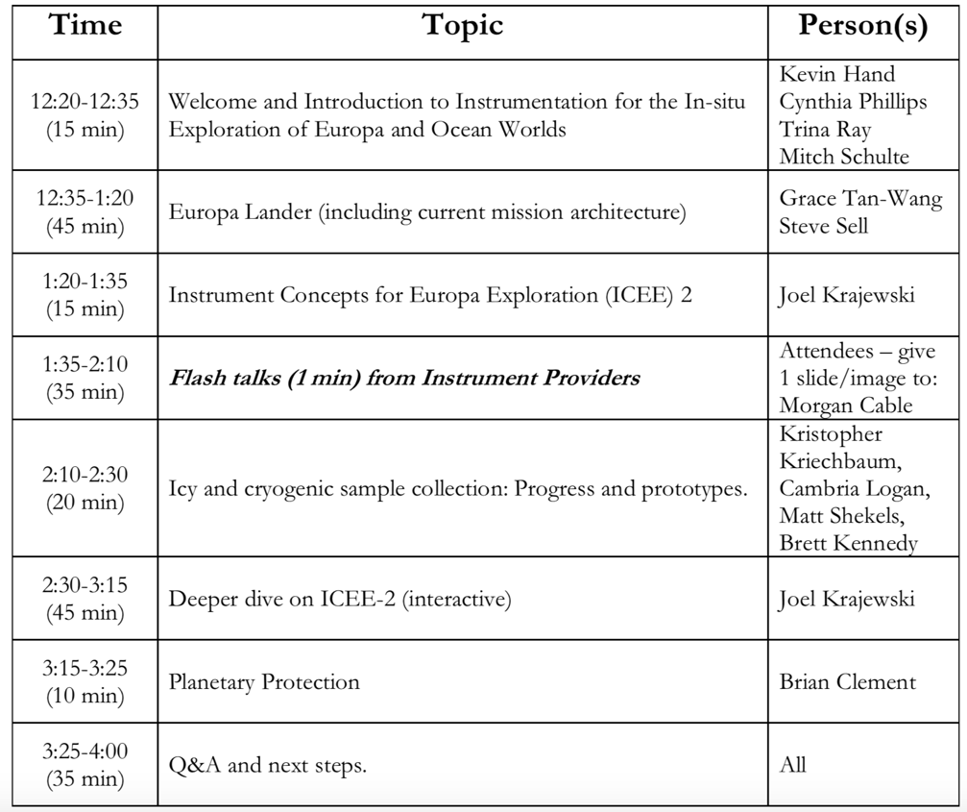
Mini-workshop Agenda
Pre-Decisional Information - For Planning and Discussion Purposes Only

Slide 3
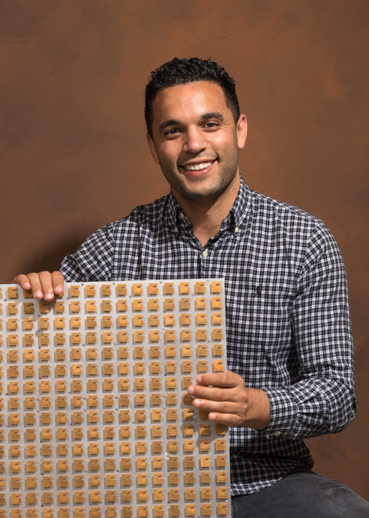
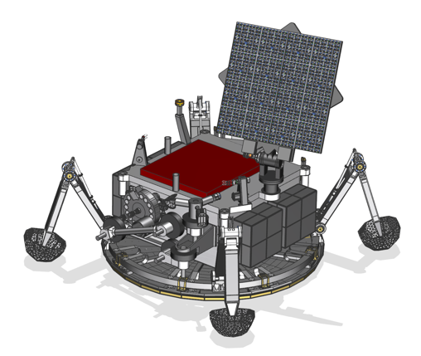
Technology Development
Direct-to-Earth Antenna
From TRL-1 to TRL-5 in 5 months
f = 7.19GHz
Artist’s concept
Gain = 29.6dBic
η = 75%
― Calc.
― Meas.
16x16 element performance
16x16 antenna
Pre-Decisional Information - For Planning and Discussion Purposes Only

Slide 4
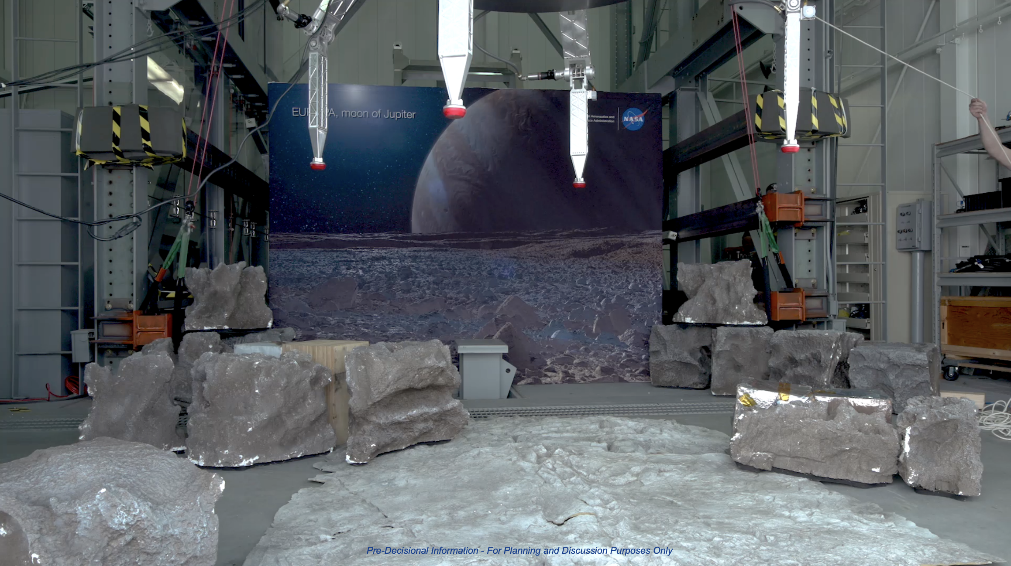
Pre-Decisional Information - For Planning and Discussion Purposes Only

Slide 5
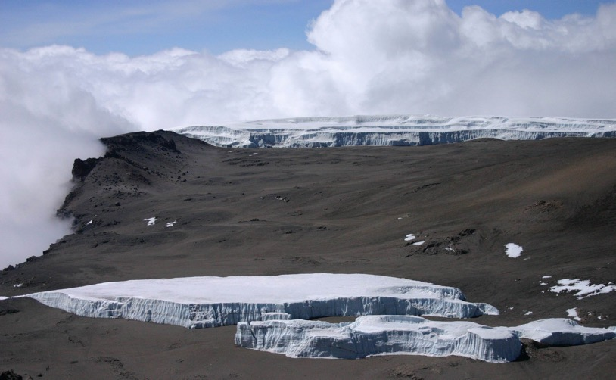
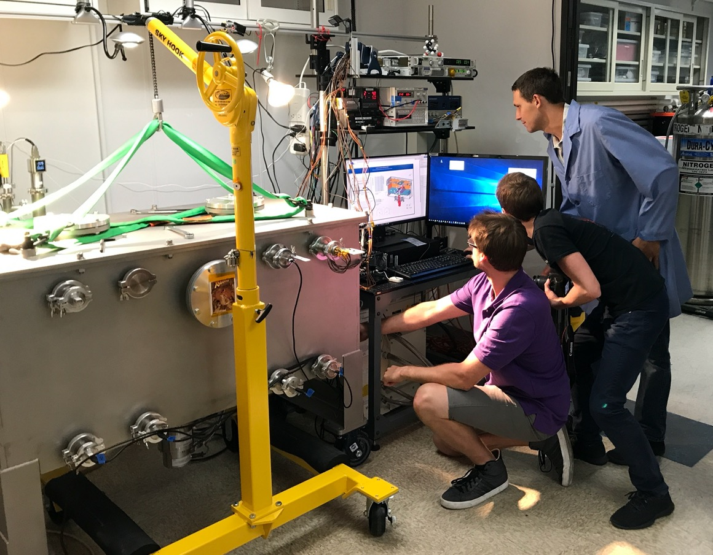
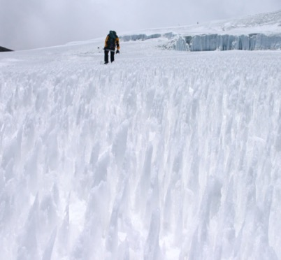
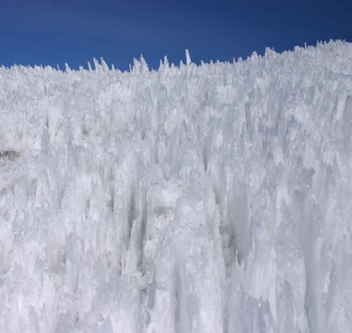
What does the surface of Europa look like?
Pre-Decisional Information - For Planning and Discussion Purposes Only

Slide 6
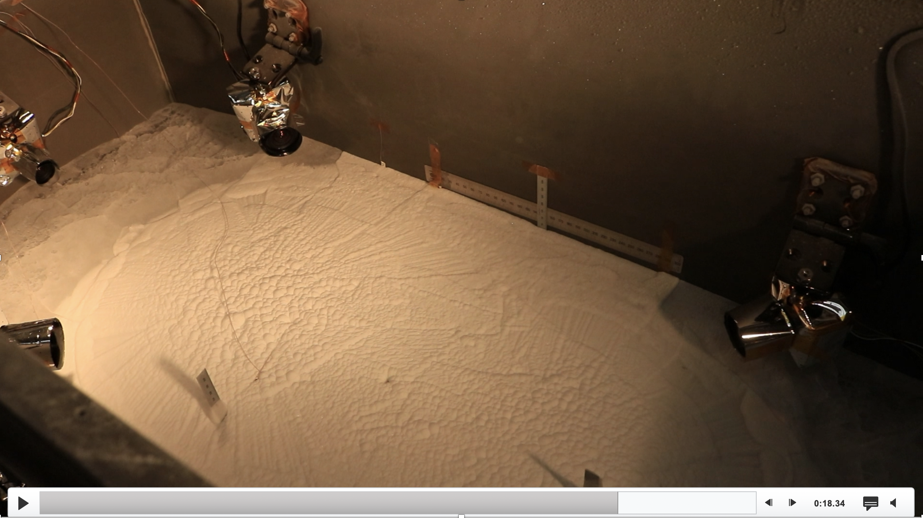
Pre-Decisional Information - For Planning and Discussion Purposes Only

Slide 7
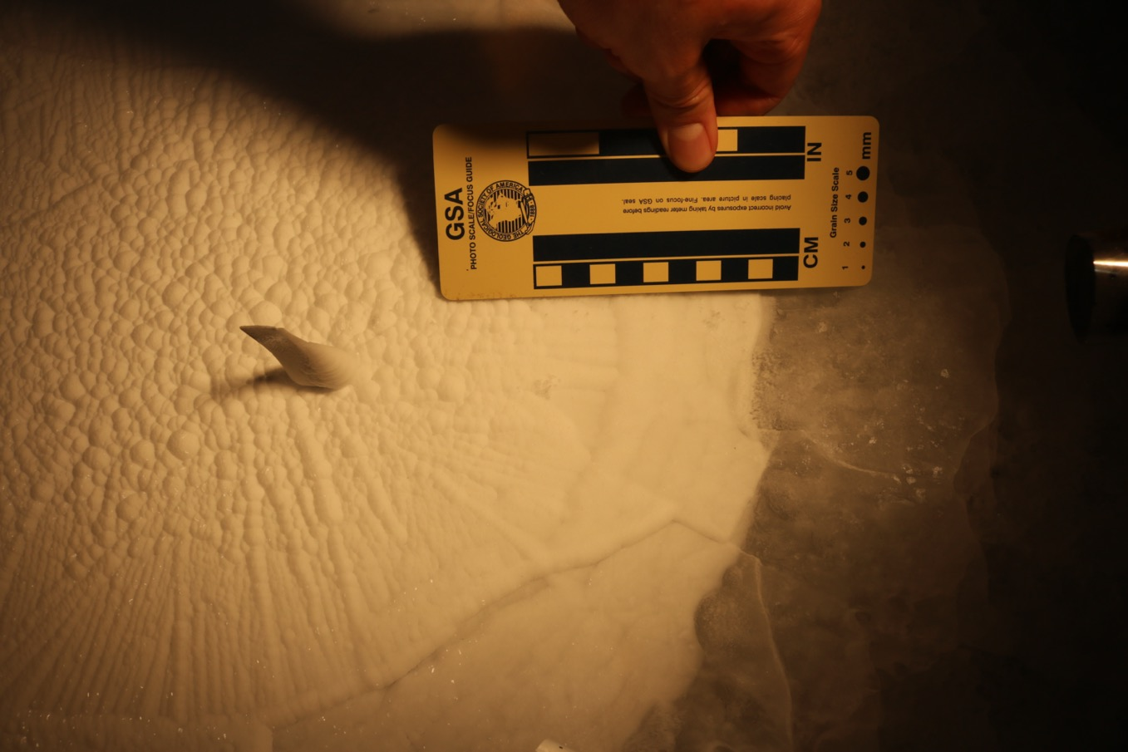
What does the surface of Europa look like?
Pre-Decisional Information - For Planning and Discussion Purposes Only

Slide 8
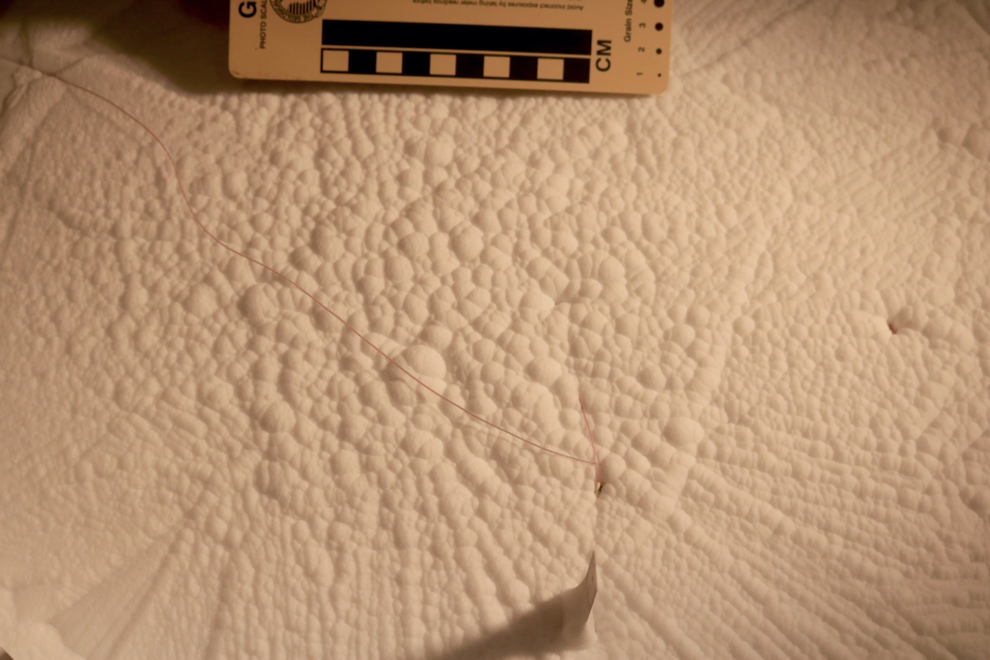
What does the surface of Europa look like?
Pre-Decisional Information - For Planning and Discussion Purposes Only

Slide 9
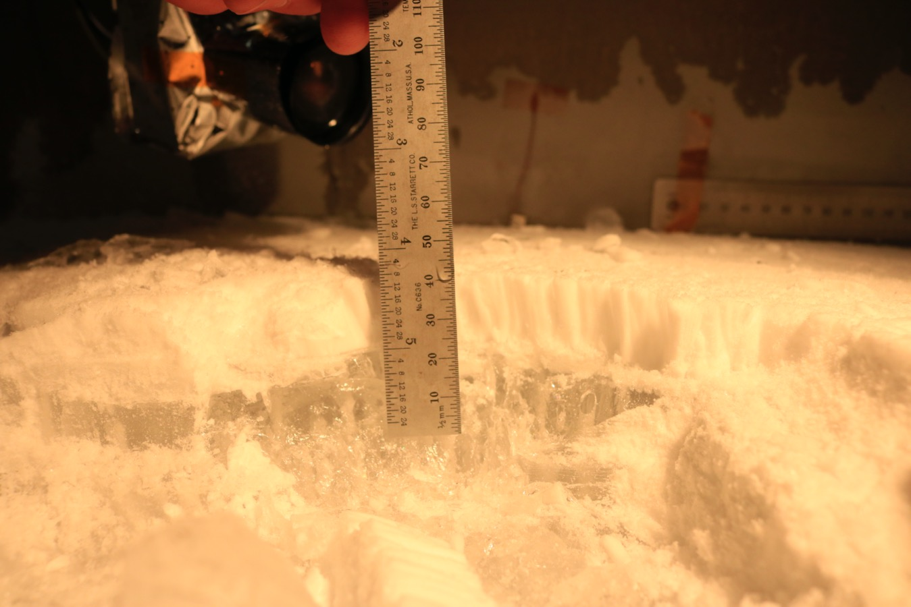
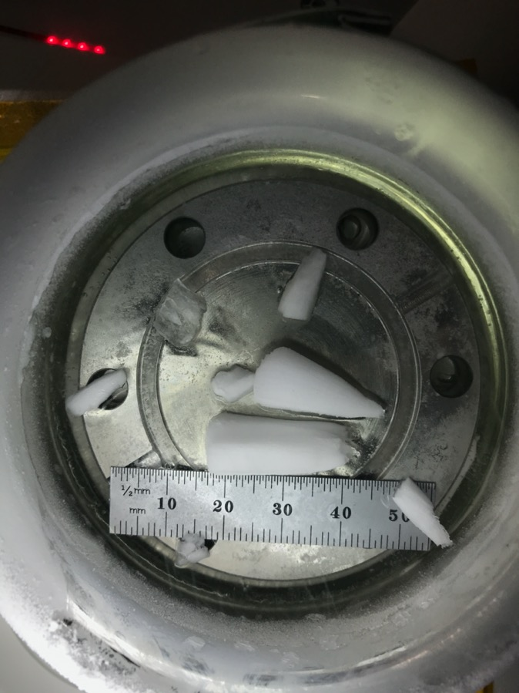
What does the surface of Europa look like?
Pre-Decisional Information - For Planning and Discussion Purposes Only

Slide 10
Europa Lander: Common Questions/Misconceptions
To be clear: Europa Clipper does not have a lander as part of the mission.
  Clipper orbits Jupiter and makes ~45+ flybys of Europa.
  Launch date: ~2023. Arrival at Jupiter: mid- to late-2020’s.
“We do not know where to land.”
  Even if we transitioned today to Phase A there would be over 3 years for landing site selection using Europa Clipper data.
    Result: Science team will have lots of time to deliberate on landing sites.
“Its not safe to land until we have data back from Clipper.”
  Europa Lander mission concept was designed with Clipper data in mind.
  The highest resolution Clipper data is ~0.5 m/pix and is insufficient to change the architecture and mechanical design of the lander (also minimal impact on cost).
    Result: We would need to change Clipper payload if the above is taken as a true statement.
  Landing close in time with respect to reconnaissance data reduces risk.
    Result: Land as close in time relative to the recon data as you can.
Pre-Decisional Information – For Planning and Discussion Purposes Only

Slide 11
Europa Lander Status
Europa Lander pre-Project status
  Held delta-Mission Concept Review (MCR) in Nov. 2018
    “The review board (chaired by Bobby Braun) cannot recall a pre-phase A planetary science concept at this advanced level of fidelity”
  FY19 budget signed, but near-term budgets unlikely to include funding levels required for new start
NASA selected 14 potential instruments for maturation under Instrument Concepts for Europa Exploration 2 (ICEE-2) @ ~$2M each for 2 years
  Funded out of FY18 budget
High-priority Advanced Development maturation tasks have begun
  Funded out of FY19 budget
  Reduces flight development risk
  Many tasks applicable to projects beyond Europa Lander
Pre-Decisional Information – For Planning and Discussion Purposes Only
The cost information contained in this document is of a budgetary and planning nature and is intended for informational purposes only. It does not constitute a commitment on the part of JPL and/or Caltech.

Slide 12
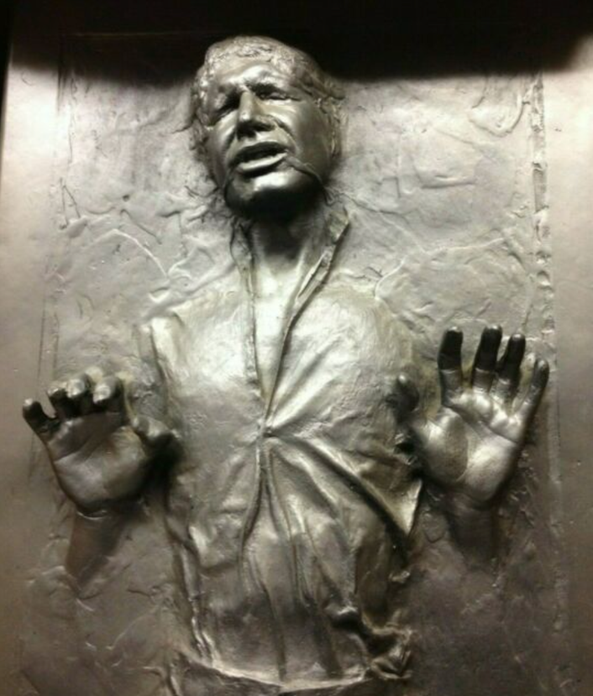
Europa Lander Next Steps
Transition to Phase A halted.
Decisions likely deferred until next decadal survey (~2023).
Pre-Decisional Information – For Planning and Discussion Purposes Only

Slide 13
Mini-workshop Agenda
Pre-Decisional Information - For Planning and Discussion Purposes Only

Slide 14
Advanced Development Activities
Update launch opportunities and perform flight system impact assessment
  Launch Period Survey and Interplanetary Trajectories
  Navigating 3-body arrival with a short period
  Support to Clipper Reconnaissance Focus Group
  Assess DDL/Nav trade space
De-orbit, Descent, and Landing (DDL)
  DDL sensors
    Reduce sensor hardware and algorithm development risk
  Landing
    Prototype and test landing system (legs, feet, bellypan) concepts for very rugged terrain
  Propulsion
    Prototype and test low-thrust throttleable engine
    Environmentally test solid rocket motor propellant and ignition system
Pre-Decisional Information – For Planning and Discussion Purposes Only

Slide 15
Advanced Development Activities
Surface
  Sampling
    Prototype and environmentally test excavation, acquisition, and sample transfer techniques
      Interact with ICEE-2 selectees to conduct rapid-prototype evaluation of interfaces
    Develop approaches to maintain samples <150K
  Autonomy: Develop and test concepts for highly autonomous operations
    Develop software simulation and hardware testbed for development of autonomy designs
    Mature autonomy sensing, closed-loop control, and computational requirements
  Resources (size/weight/power/life/computation)
    Develop and test lightweight, low-power motor controller
    Continue radiation and life testing of primary batteries
    Develop and test full-scale High-Gain Antenna
  Planetary Protection/Contamination Control
    Conduct planetary protection/bioburden analyses to mature payload and flight system requirements
    Continue development of Terminal Sterilization System
    Evaluate outgassing properties of radiation-exposed materials
    Assess plume product interaction and alteration with cryogenic ices
Pre-Decisional Information – For Planning and Discussion Purposes Only
The cost information contained in this document is of a budgetary and planning nature and is intended for informational purposes only. It does not constitute a commitment on the part of JPL and/or Caltech.

